Slide 1
3 option group project
Prepared by Panasenkov Vladimir, Piskaeva Zlata, Tonoyan Seda, Khabibulina Elya

Slide 2
Table of contents
01
02
03
04
Data accumulation
Visualization
Data analysis
Notifications

Slide 3

01
Data accumulation

Slide 4
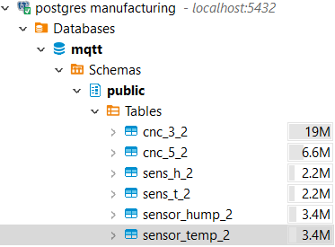
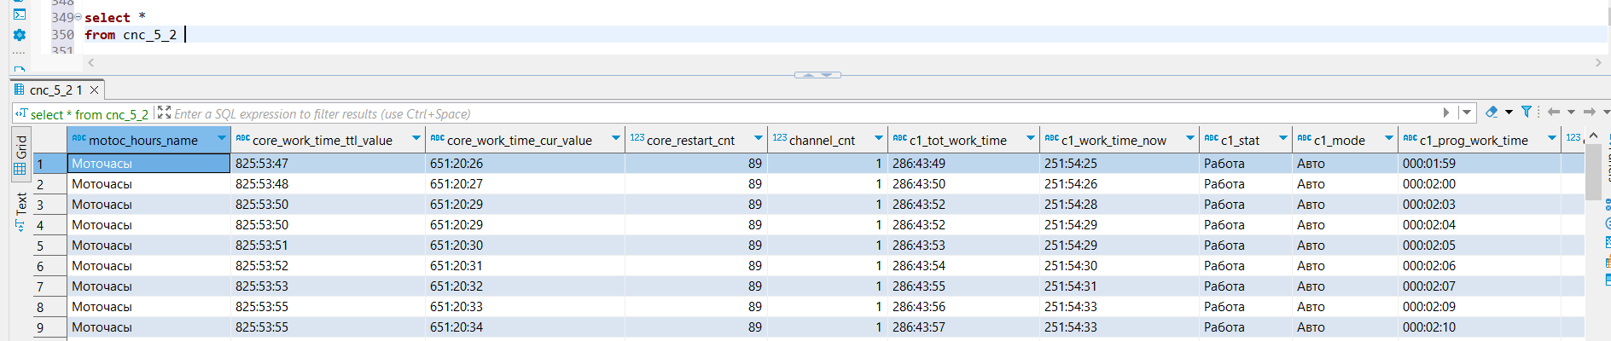
01
Data accumulation - Postgres DataBase
Created “mqtt” database and 6 tables in it:
cnc_3_2 - for CNC 3 machine
cnc_5_2 - for CNC 5 machine
sens_h_2 - for sens/h mqtt topic
sens_t_2 - for sens/h mqtt topic
sensor_hump_2 - for sensor/hump mqtt topic
sensor_temp_2 - for sensor/temp mqtt topic

Slide 5
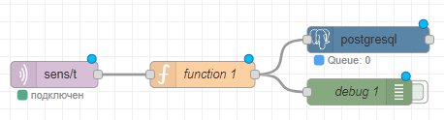
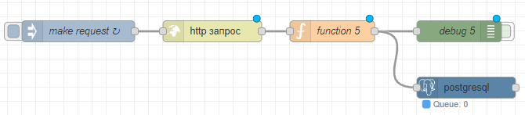
Node-RED reading and writing data
Reading data from machines/topics
Converting data:
json parsing
adding timestamp
removing service characters
Writing data to the db

Slide 6


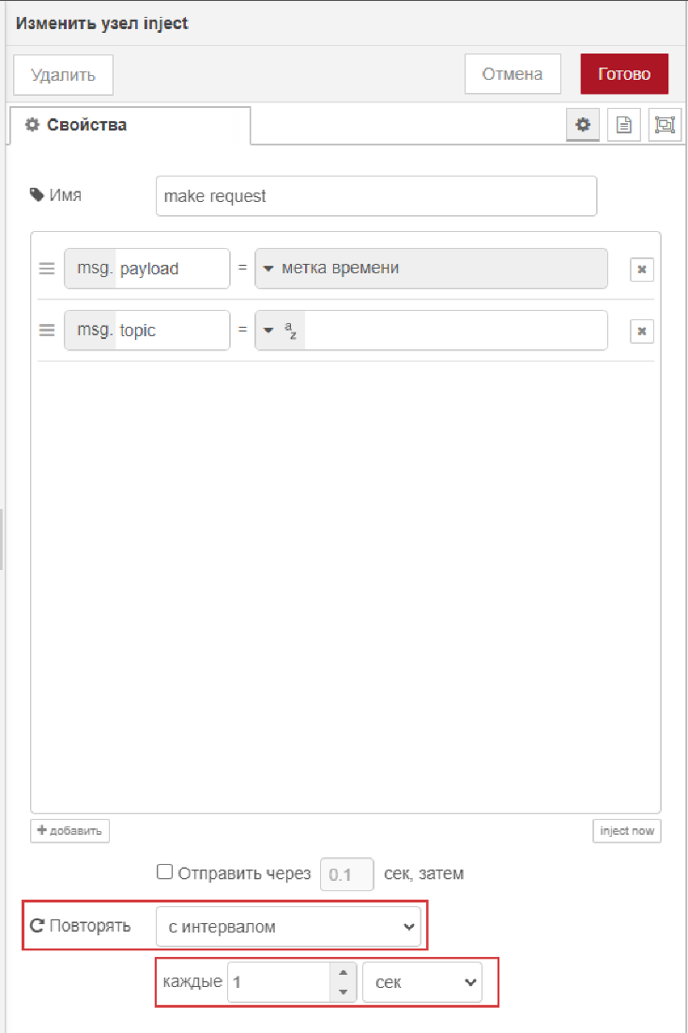
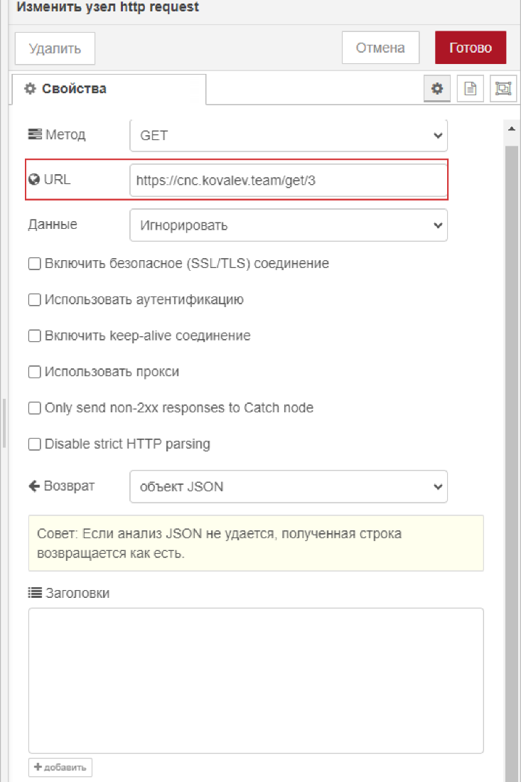

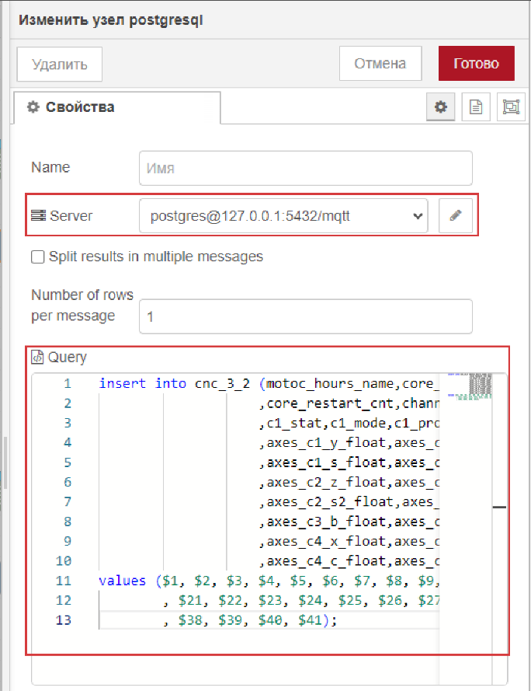

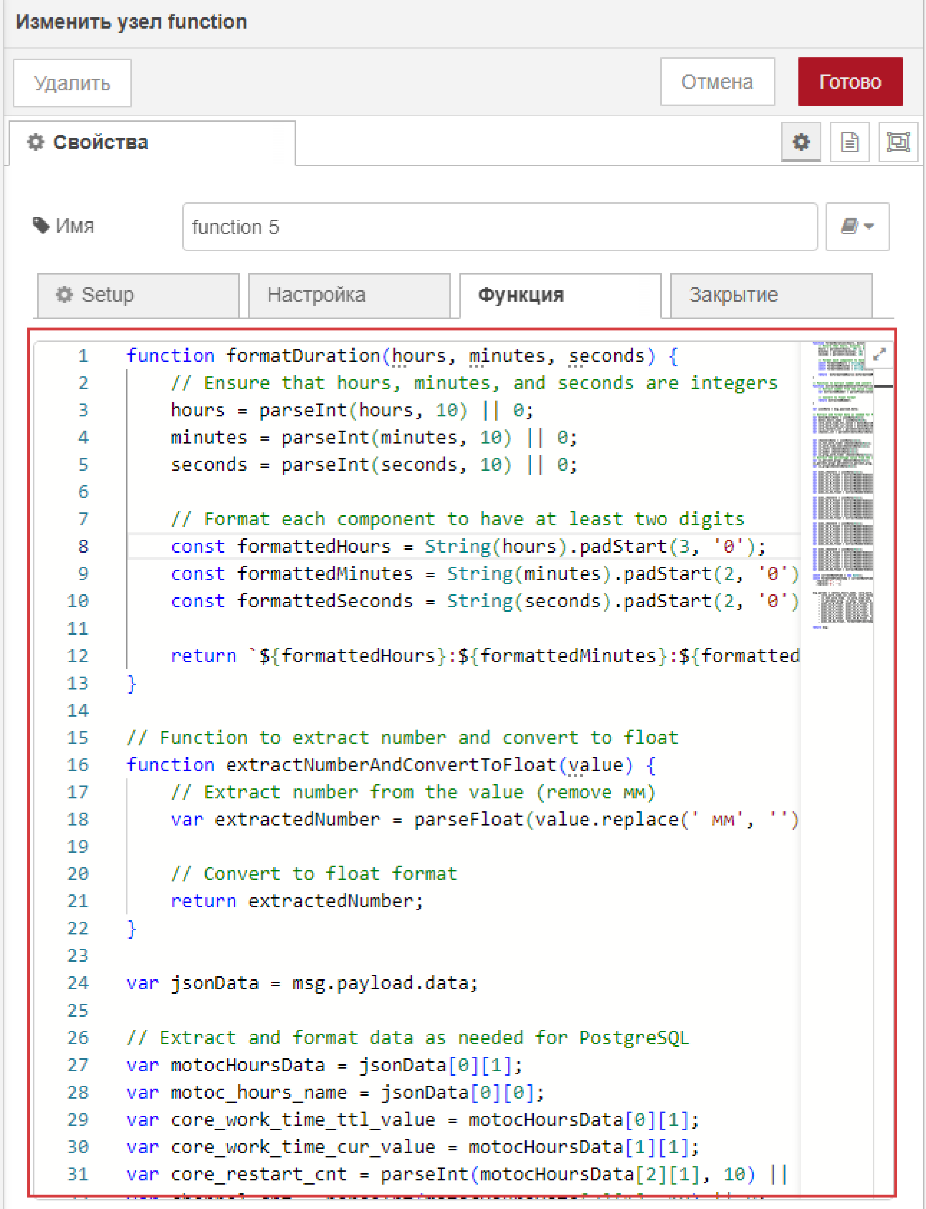
Node-RED reading and writing data - CNC

Slide 7
02
Visualization

Slide 8
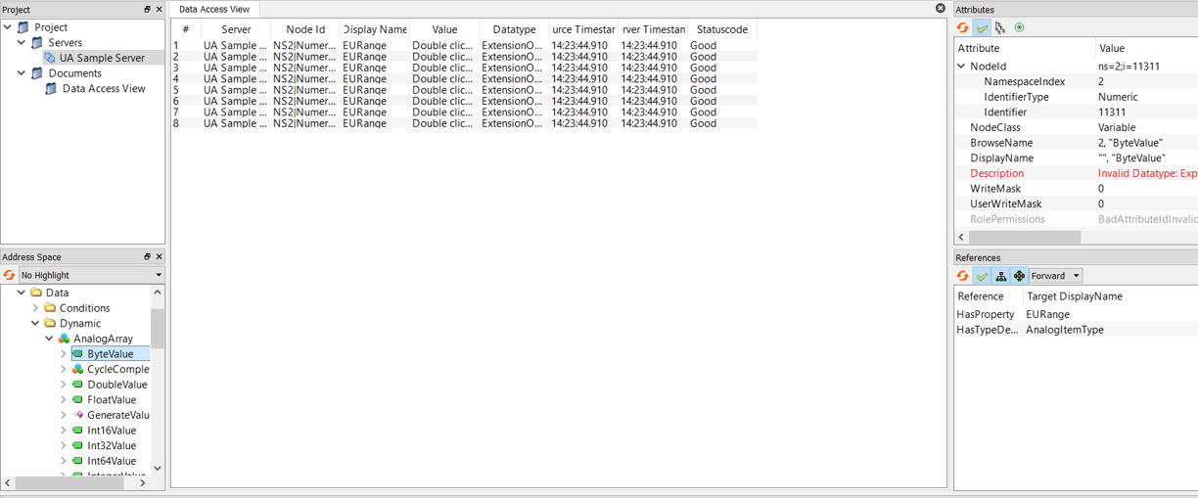
OPC UA vis. settings
Connection to the server
Identification of the dynamic values

Slide 9
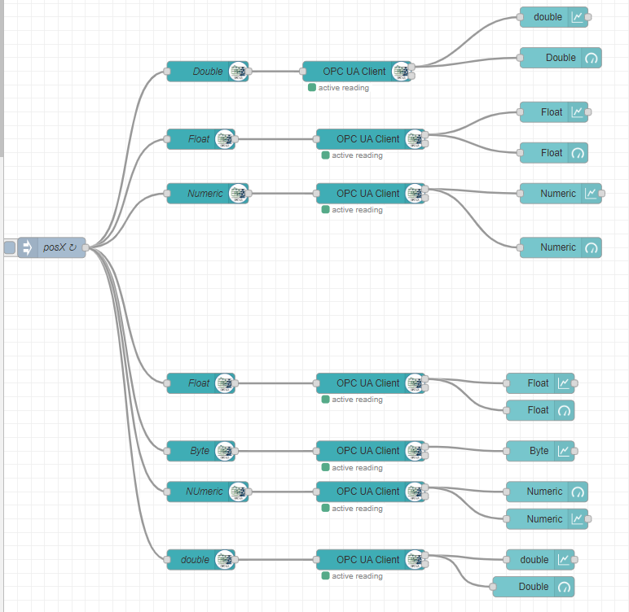
OPC UA vis. flow

Slide 10
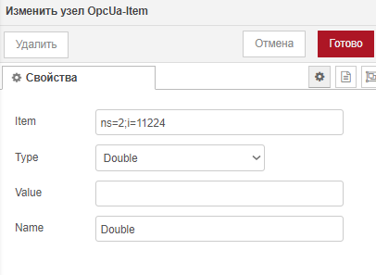
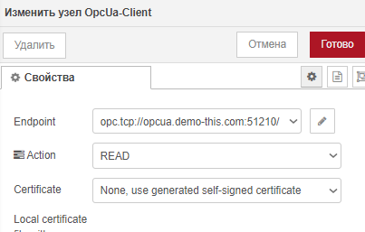
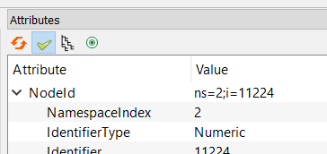
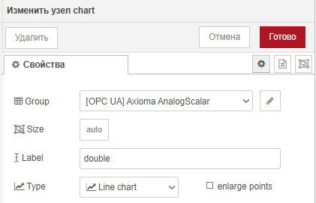
OPC UA vis. Node settings

Slide 11
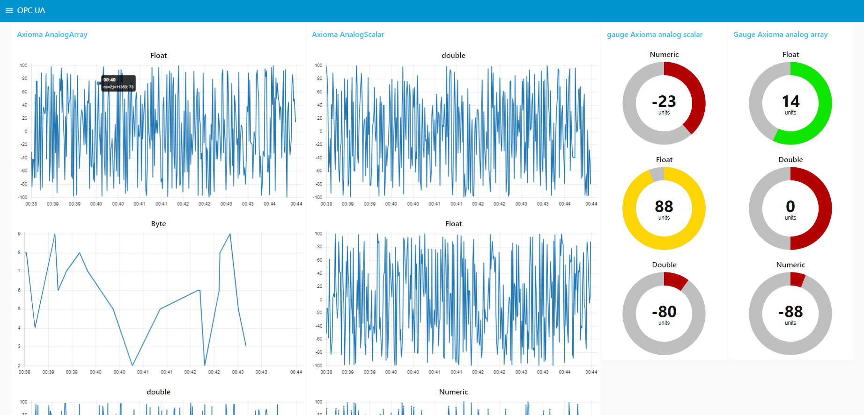
OPC UA visualisation

Slide 12
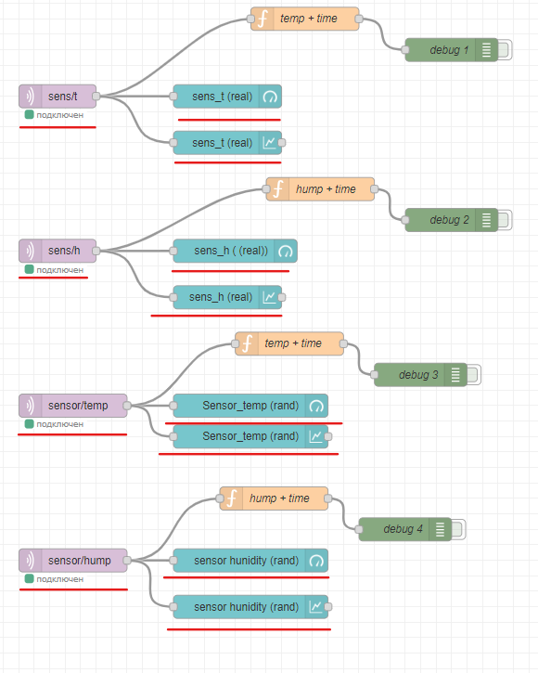
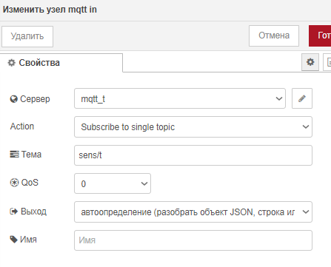
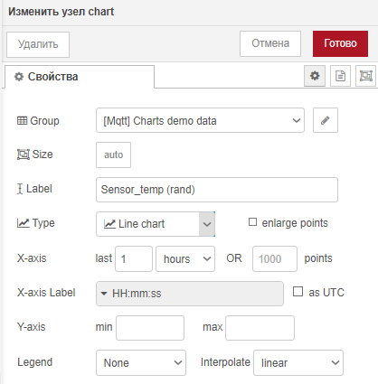
MQTT Sensor vis. flow

Slide 13
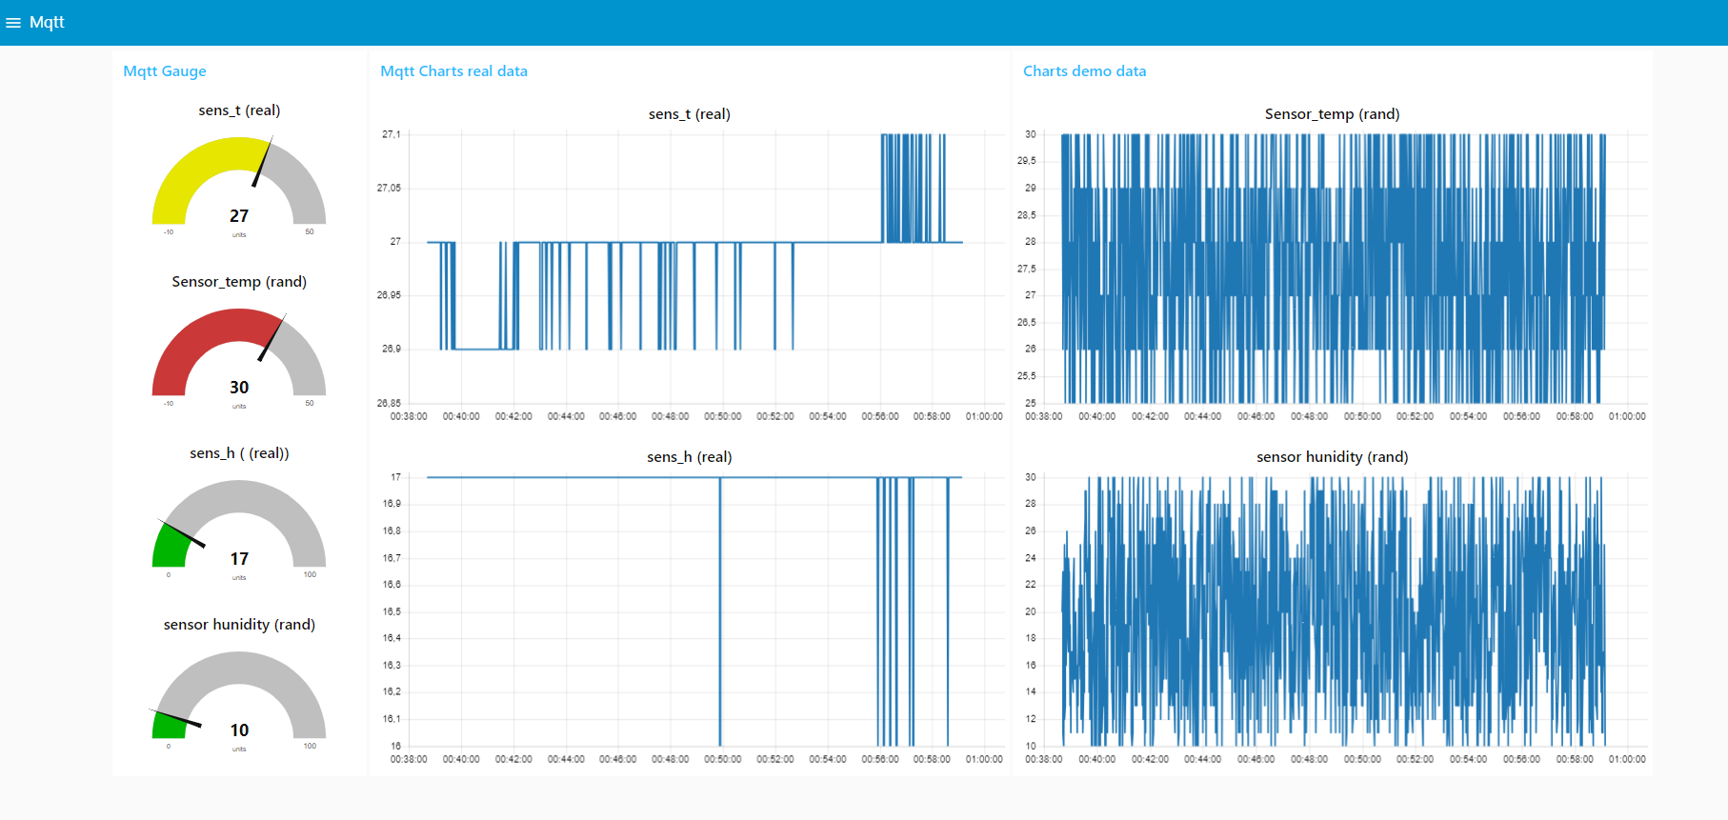
MQTT Sensor visualisation

Slide 14
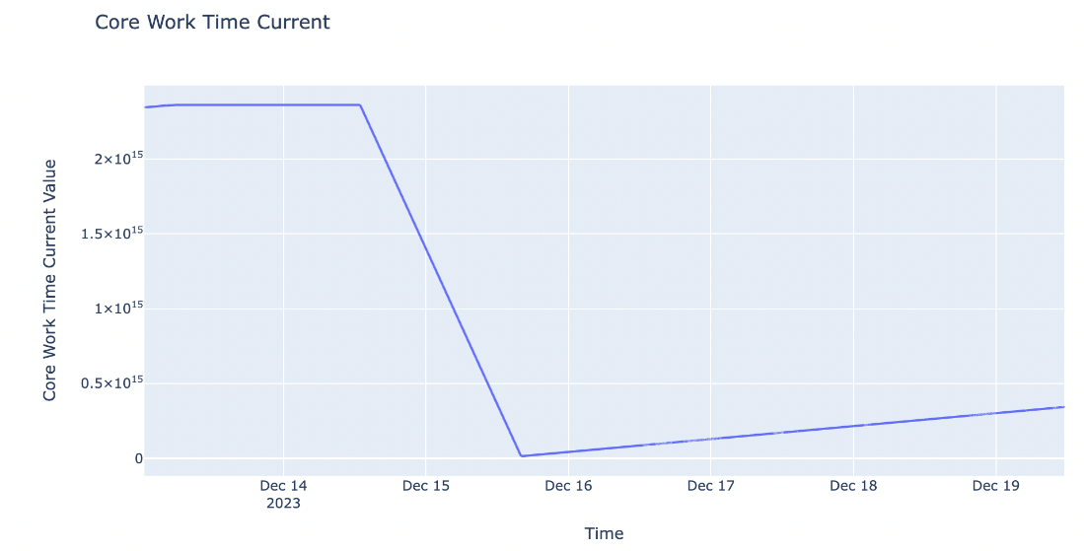
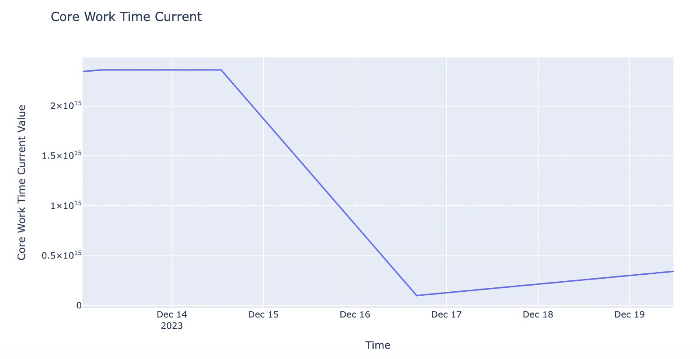
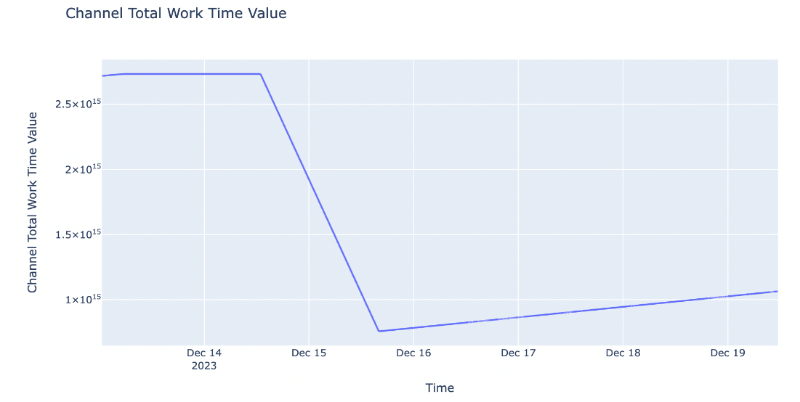
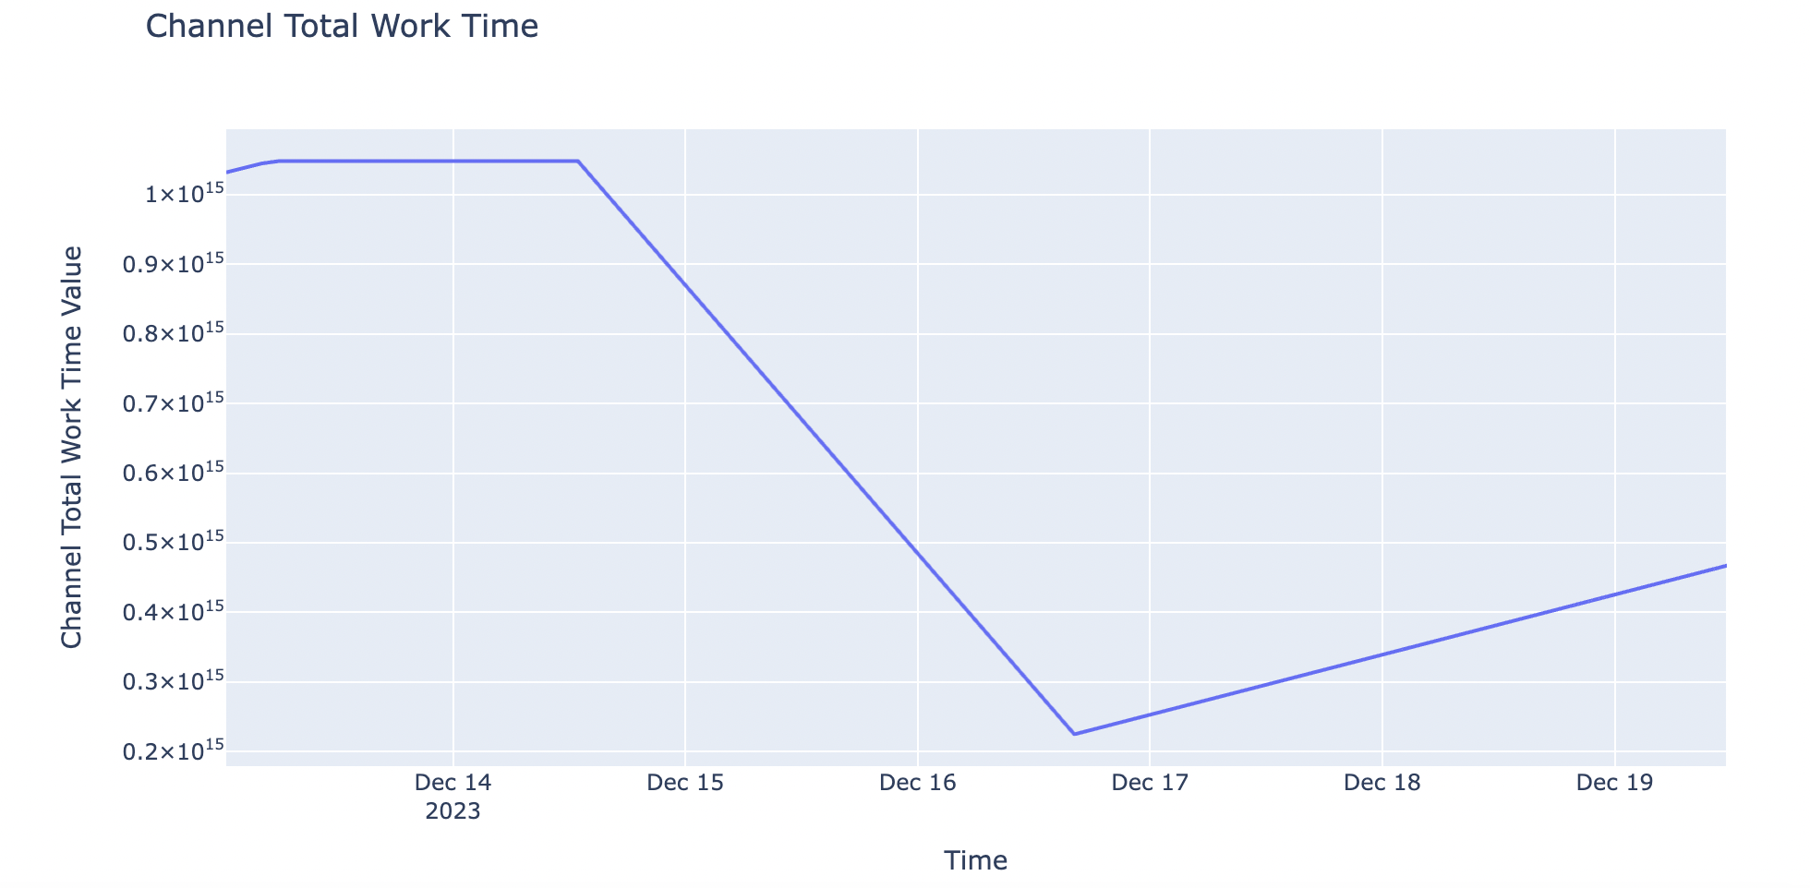
Core Work time current and Channel Total Work Time dynamic
CNC 3
CNC 5

Slide 15
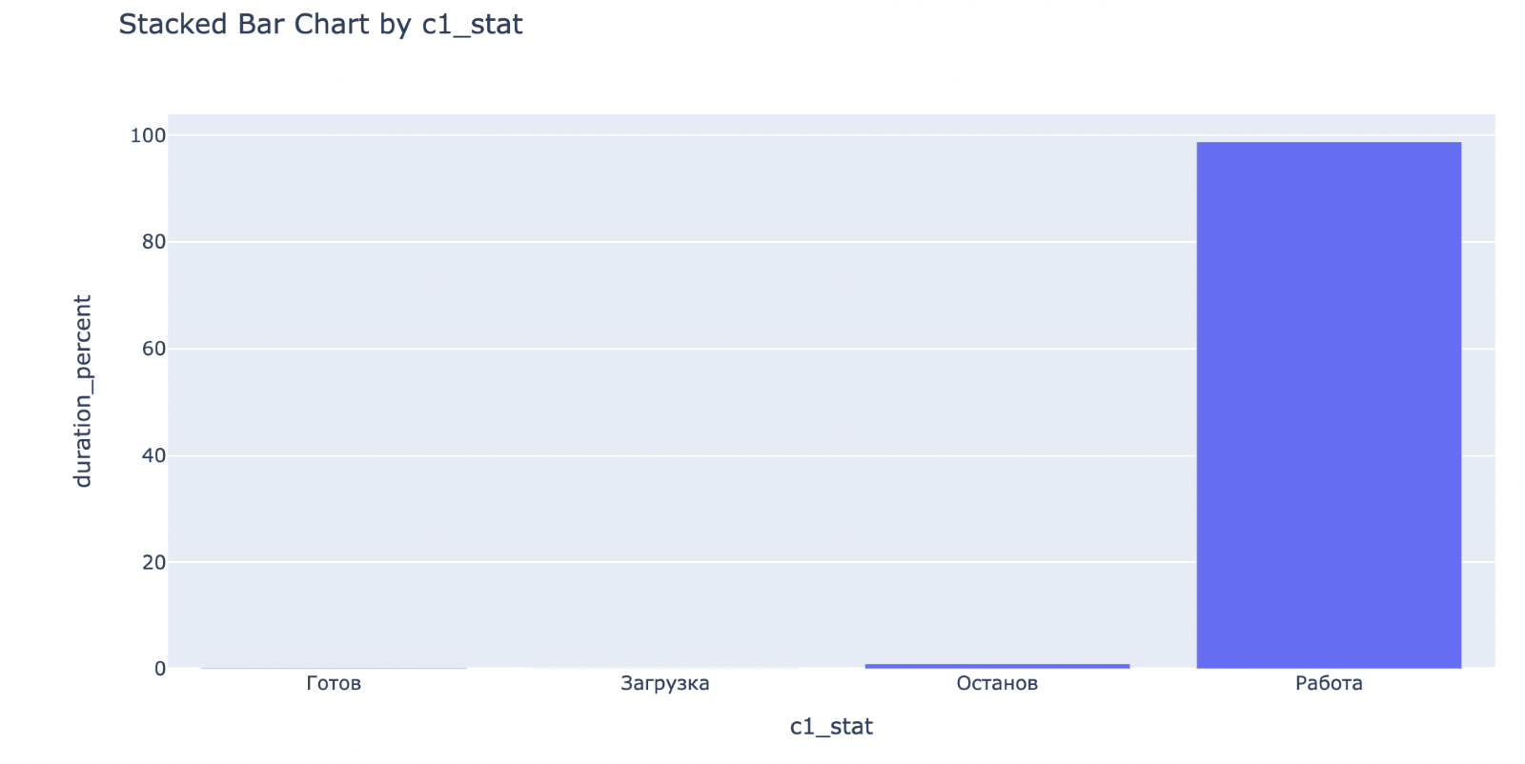
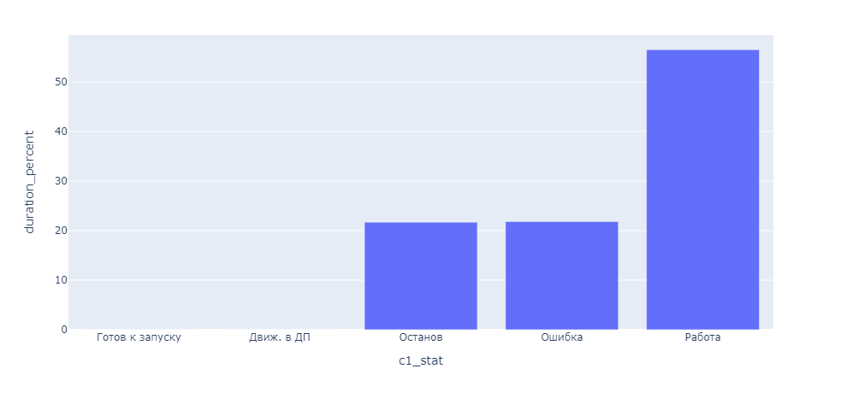
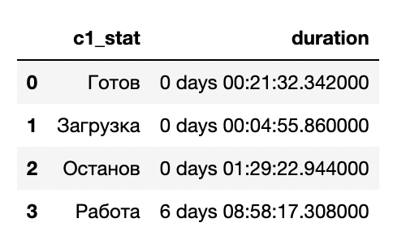
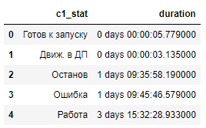
Status of channel
CNC 3
CNC 5

Slide 16
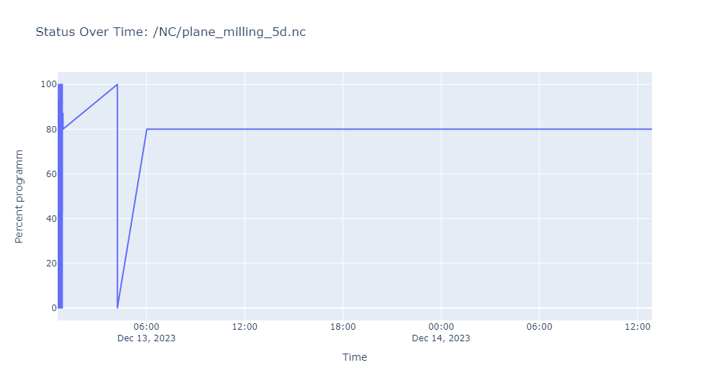
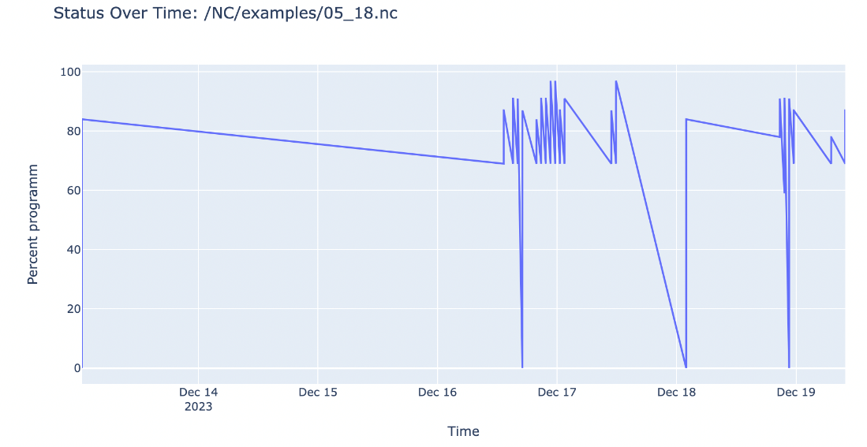
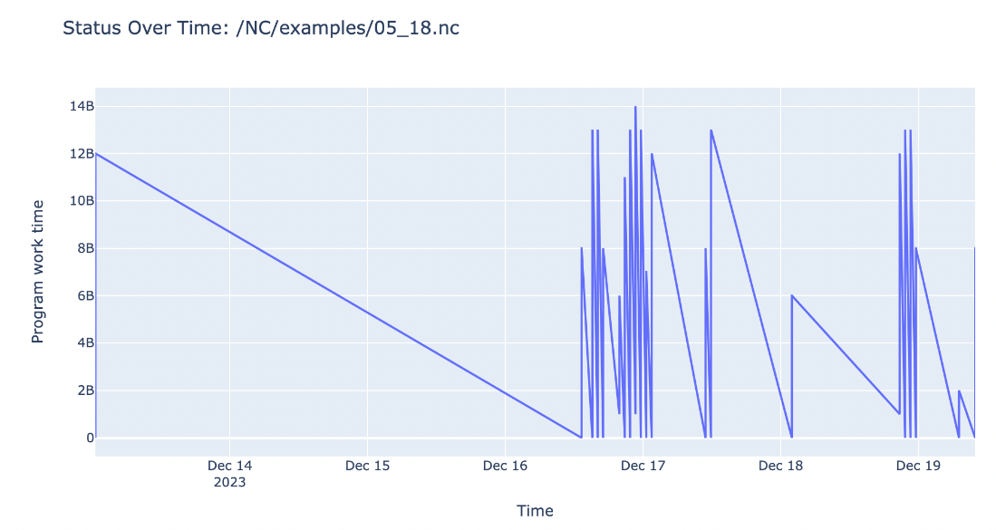
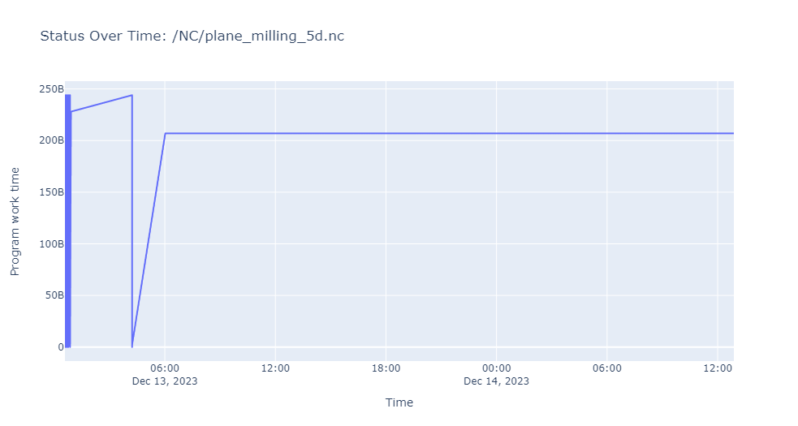
Percentage of program completion and its work time
CNC 3
CNC 5
Percentage of program completion
Program work time evaluation

Slide 17
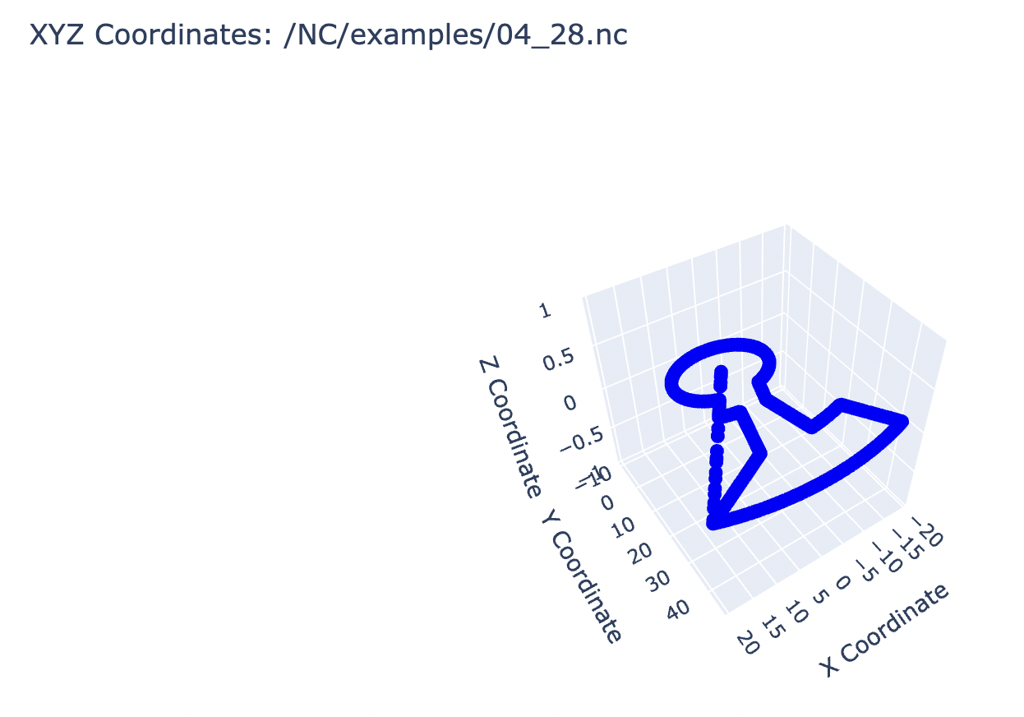
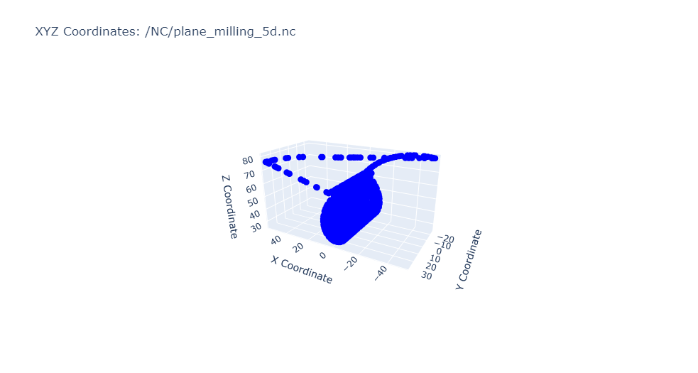
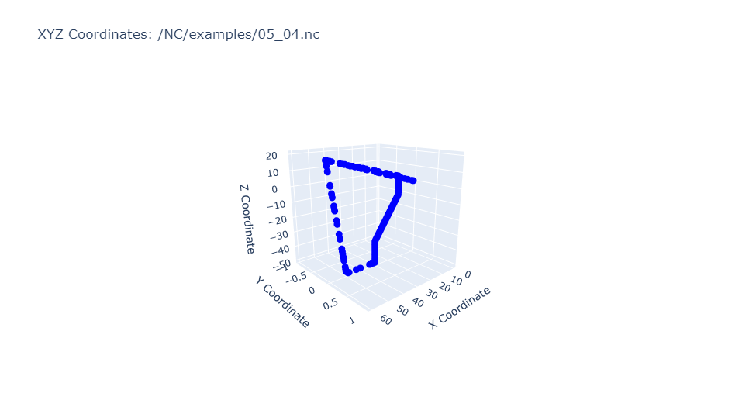
Channel 1 coordinates
CNC 3
CNC 5

Slide 18
03
Data Analysis

Slide 19
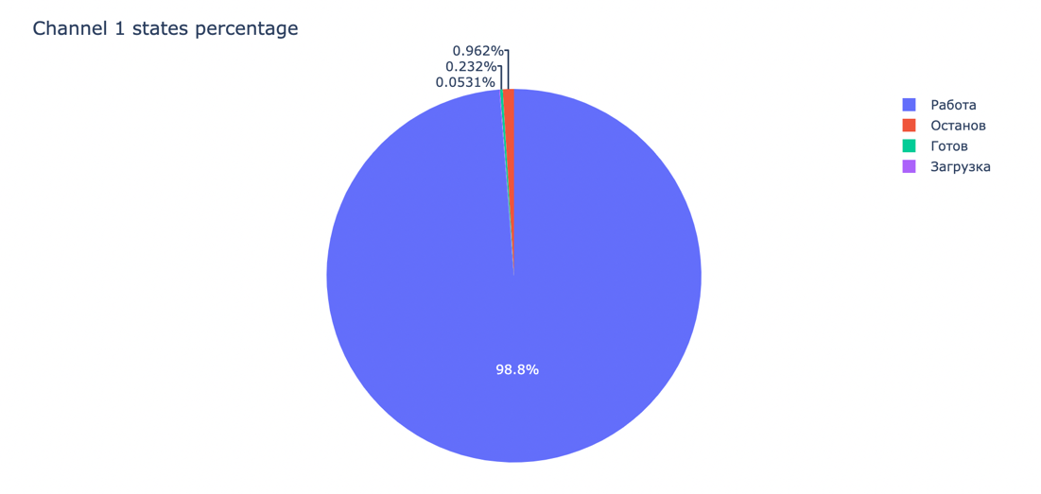
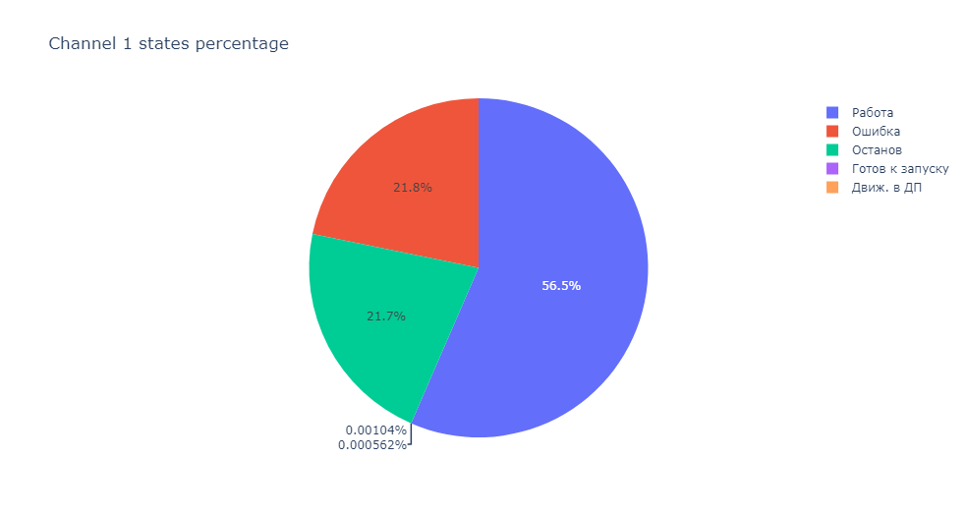
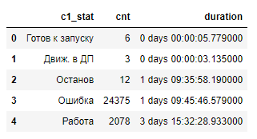
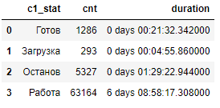
State of the CNC
CNC 3
CNC 5

Slide 20
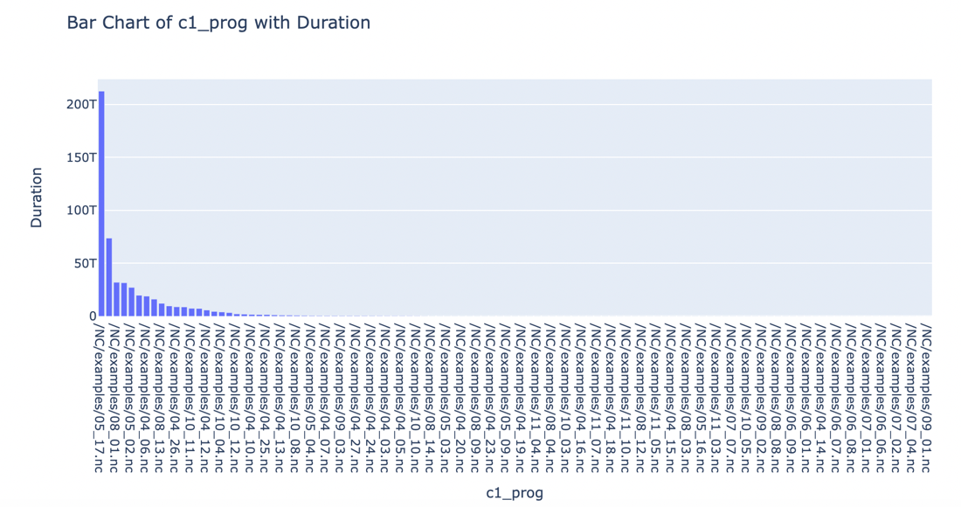
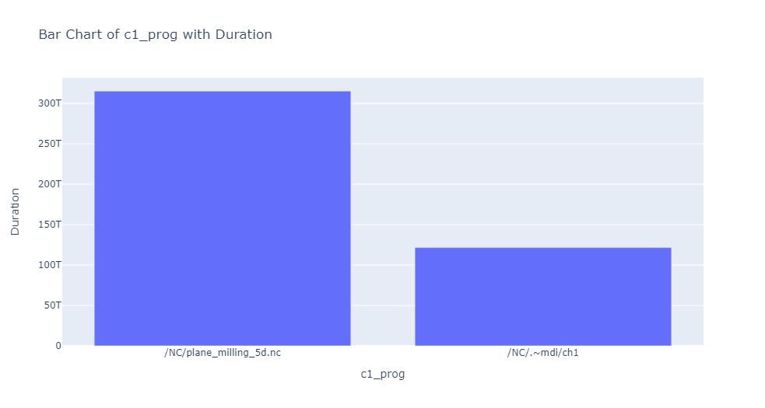
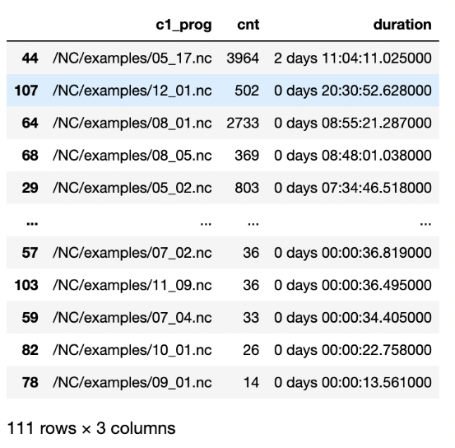
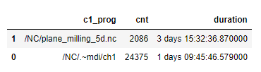
Programm running the most time
CNC 3
CNC 5

Slide 21
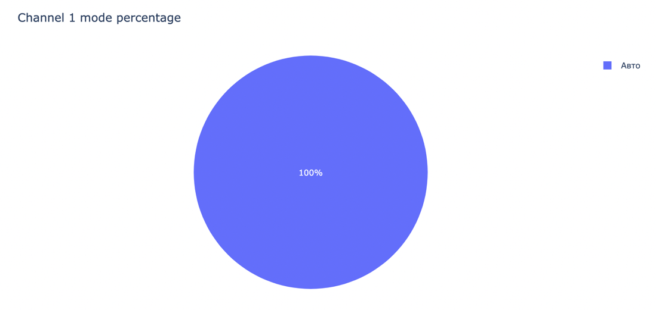
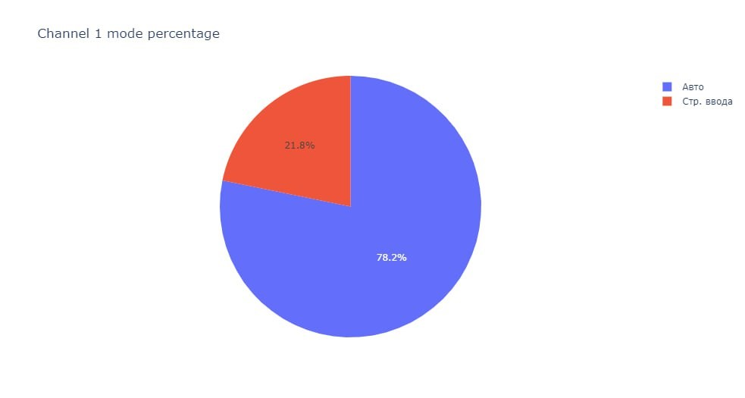
Mode CNC was in the most time
CNC 3
CNC 5

Slide 22
Online and offline modes
CNC 3
CNC 5
Total online duration: 0 days 18:45:38
Total offline duration: 5 days 15:49:17
Total online duration: 0 days 07:09:52 Total offline duration: 6 days 03:38:58
Total online duration per date:
timestamp_msc
2023-12-13 0 days 00:31:04
2023-12-14 0 days 00:02:10
2023-12-15 0 days 00:02:16
2023-12-16 0 days 08:07:22
2023-12-17 0 days 03:24:25
2023-12-18 0 days 05:07:05
2023-12-19 0 days 01:31:16
Total offline duration per date:
timestamp_msc
2023-12-13 0 days 22:53:23
2023-12-14 0 days 23:57:45
2023-12-15 0 days 23:57:41
2023-12-16 0 days 15:41:46
2023-12-17 0 days 20:31:50
2023-12-18 0 days 18:49:59
2023-12-19 0 days 09:56:53
Total offline duration per date: timestamp_msc 2023-12-13 0 days 22:53:24 2023-12-14 0 days 23:57:45 2023-12-15 1 days 00:00:00 2023-12-16 0 days 23:59:57 2023-12-17 0 days 23:59:59 2023-12-18 0 days 18:50:59 2023-12-19 0 days 09:56:54
Total online duration per date: timestamp_msc 2023-12-13 0 days 00:31:02 2023-12-14 0 days 00:02:10 2023-12-16 0 days 00:00:03 2023-12-18 0 days 05:05:09 2023-12-19 0 days 01:31:28

Slide 23
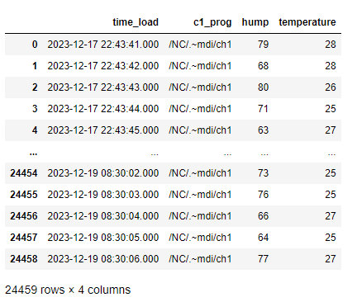
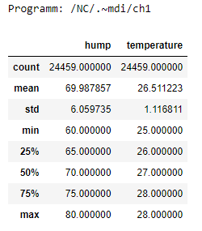
Errors
CNC 5

Slide 24
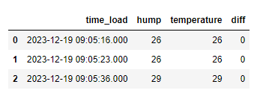
Temperature value is equal to the humidity
MQTT sensor demo

Slide 25
04
Notifications

Slide 26
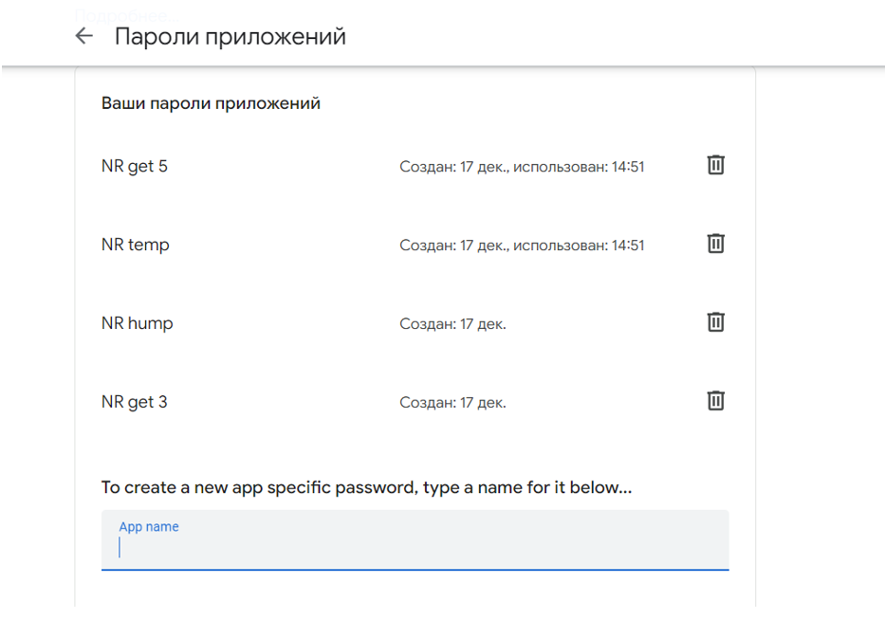
Pre notification setting
Creation of the sender mail
Creation of the app passwords

Slide 27
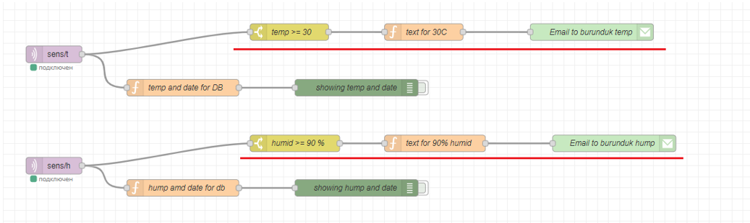
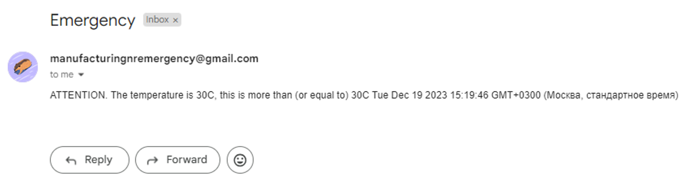
Notifications for sensors

Slide 28



Settings of the nodes for sensors

Slide 29


Notification setting for CNCs

Slide 30


Settings of the nodes for CNC

Slide 31

Results of the notifications

Slide 32
Thank you for attention

Slide 33
00
Appendix

Slide 34

OPC UA visualisation Charts
Float Analog Array

Slide 35
OPC UA visualisation Charts
Float Analog Scalar

Slide 36




Channel mode
CNC 3
CNC 5

